Slide 1



Day 32
contact@anubhavtrainings.com
ABAP RESTFUL APPLICATION PROGRAMMING

Slide 2

Agenda – Day 32
What is Draft
Enable Draft Handling
Expose Draft handling to projection Layer
Enable Early Numbering for Travel and Booking
Integrating augment in Managed Object

Slide 3
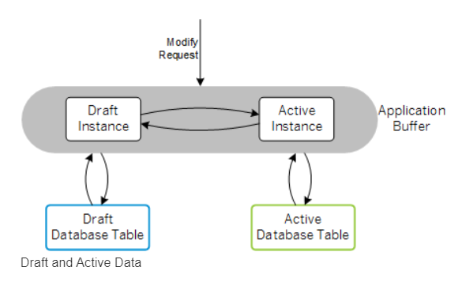
What is Draft?
You can draft-enable a business object to automatically persist transactional data in the backend. This approach supports stateless communication for your applications.
Modern cloud-ready apps require a stateless communication pattern, for example to leverage cloud capabilities like elasticity and scalability. Thus, there is no fixed backend session resource along a business transaction for each user and the incoming requests can be dispatched to different backend resources, which supports load balancing. On the other hand apps are stateful from end-user perspective. Business data that is entered by the end user needs to be locked, validated and enriched via ABAP business logic on backend side.
The draft concept fills the gap between a stateless communication pattern and a stateful application by applying REST principles:
The draft represents the state and stores the transactional changes on the database in shadow tables. It is an addressable resource, the exact copy of the active data that is currently being edited.
Draft-enabled applications allow the end user to store changed data in the backend and continue at a later point in time or from a different device, even if the application terminates unexpectedly.

Slide 4
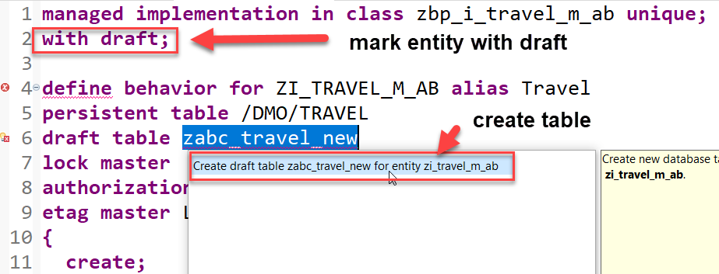
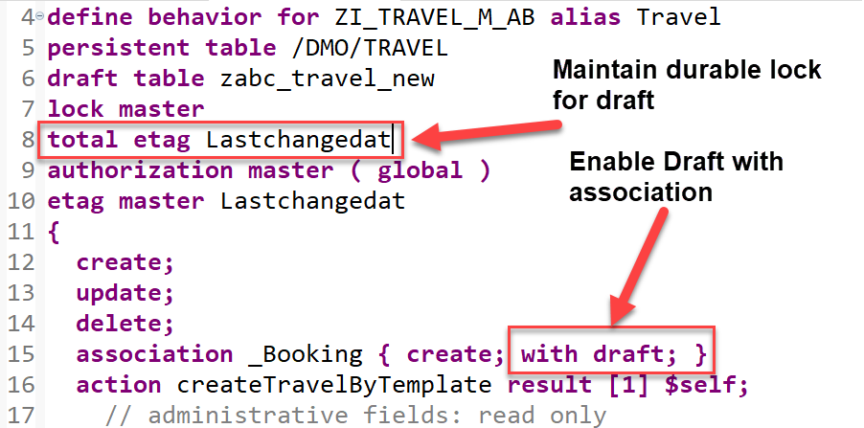
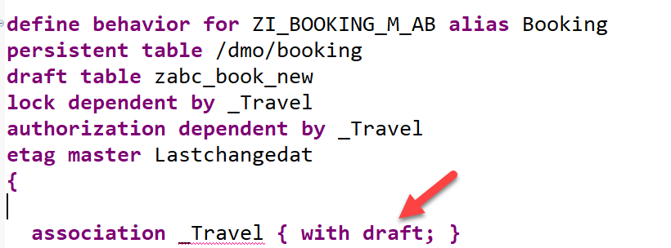
Steps to implement Draft
Draft tables are fully managed by the RAP framework at runtime
Add the addition with draft; after the managed; keyword in the header section to enable draft handling for your business object.
Specify the draft table for the travel & booking entity, where the draft travel data will be persisted as show on the screenshot.
Replace the association definition in the base behavior definition to solve the warnings indicating that the associations are implicitly draft enabled as this is a draft enabled business object. For this, use the code snippet provided below to replace the one currently defined in the travel behavior definition as shown on the screenshot. Do the same for the _Travel association.
Specify a total etag field in the root entity of your BO. This is required to identify changes to active instances in cases where the durable lock has expired. The field LastChangedAt will be used for the purpose in the present scenario.

Slide 5
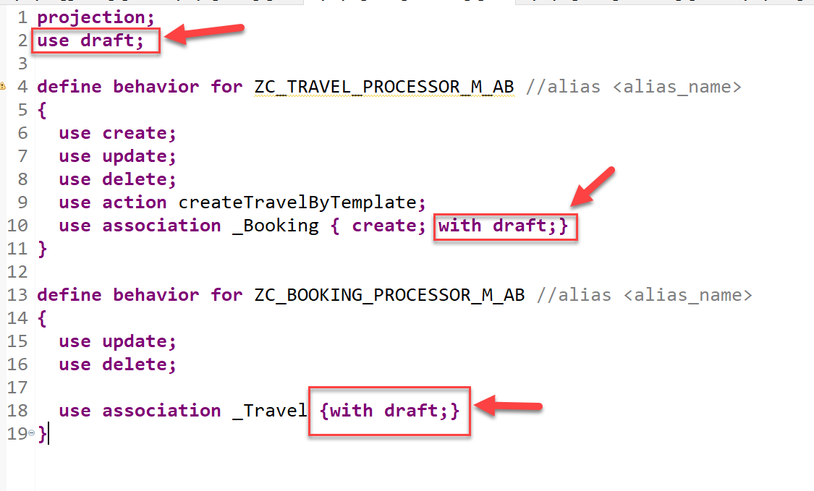
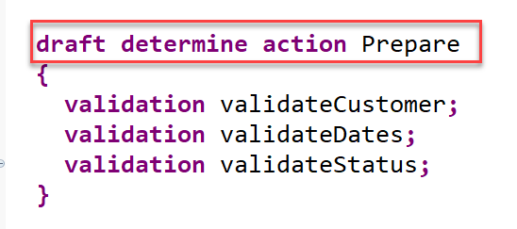
Steps to implement Draft
5. When a draft instance is going to be activated, the SAP Fiori elements UI calls the draft determine action prepare in the backend. This call takes place in a separate OData changeset to allow for saving the state messages even in case the activation fails due to failing validations. In order to execute the validations during prepare, you need to assign them to the draft determine action prepare trigger.
6. At Last, we will enable the draft handling for the managed based business object (BO) with a few additions in the behavior definition.
Draft Implementation Code

Slide 6

Enable Early Numbering for Travel and Booking
About Numbering
Numbering is about setting values for primary key fields of entity instances during runtime.
The primary key of a business object entity can be composed of one or more key fields, which are identified by the keyword key in the underlying CDS view of the business object. The set of primary key fields uniquely identify each instance of a business object. The primary key value of a business object instance cannot be changed after the CREATE.
There are various options to handle the numbering for primary key fields depending on when (early or late during the transactional processing) and by whom (consumer, application developer, or framework) the primary key values are set. You can assign a numbering type for each primary key field separately.
Early and Late Numbering
In an early numbering scenario, the primary key value is set instantly after the modify request for the CREATE is executed. The key values can be passed externally by the consumer or can be set internally by the framework or an implementation of the FOR NUMBERING method. For more information, see Early Numbering.
In a late numbering scenario, the key values are always assigned internally without consumer interaction after the point of no return in the interaction phase has passed, and the SAVE sequence is triggered. This ensures a gap free key value assignment like it is required for example for invoices. For more information, see Late Numbering.

Slide 7
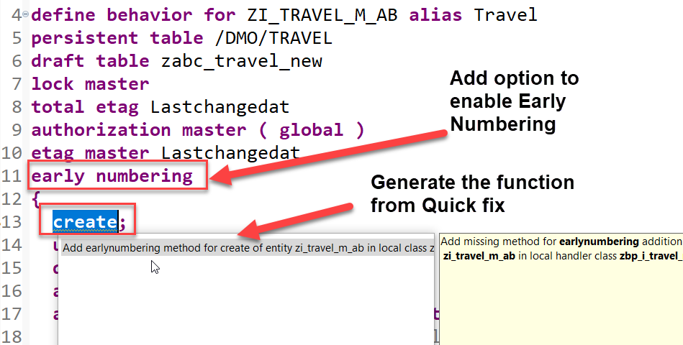
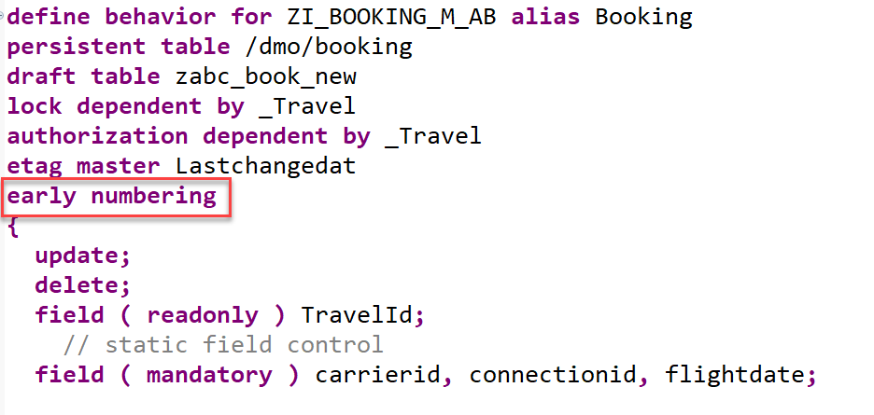
Implementation for Early Numbering
Add the addition early numbering keyword as shown below to enable early numbering for your travel entity.
The ADT Quick Fix feature can be used to add the earlynumbering method for travel entity.
Implement the function to handle early numbering – code here
Repeat the same for the booking by adding early numbering
Implement the function to handle early numbering – code here

Slide 8
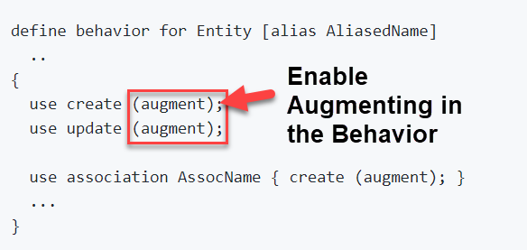
What is Augmenting
With an augmentation implementation you can add data or modify incoming requests on the projection layer before data reaches the transactional buffer. You can add data to a modify request or issue additional requests by augmenting the operation before the request is passed to the base business object.
Use case
• Defaulting for incoming requests.
• Behavior-enabling denormalized fields, for example enabling editing of language dependent fields.
Definition
Augmentation is defined in the projection behavior definition on the relevant operation with the following syntax:

Slide 9
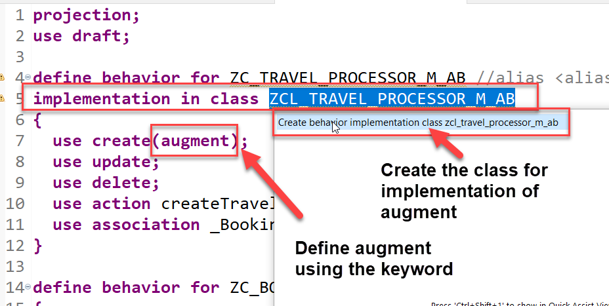
Use case and Implementation
We want to auto populate the agency id and the status of a new travel request during creation. The business has already provided default values which needs to be made available on fiori app.
Process
In our projection behavior definition, define augmentation for the create operation.
Add behavior implementation class to the Travel behavior.
The ADT Quick Fix feature can be used to create implementation class for travel entity.
Write the code to implement the default values for the agency id and status- Code here

Slide 10

End of Day 32
Trainer: Anubhav Oberoy

Slide 11

Trainer: Anubhav Oberoy

Slide 12
THANK YOU
If you cannot do
great things, do small things in a great way.
Anubhav Oberoy
https://www.anubhavtrainings.com

Slide 13


We’re committed to empower you to be
Most Desirable Resource
through powerful training solutions.
We build the workforce of the future.
250+
Corporate Clients
30,000+
Learners Trained
25000+
Learners Placed
FREE WEBINARS
Sign up for free webinars with industry experts every fortnight!
Enroll Now!
Contact us today!
https://anubhavtrainings.com/

Slide 14




More from AnubhavTrainings.com

